Slide 1
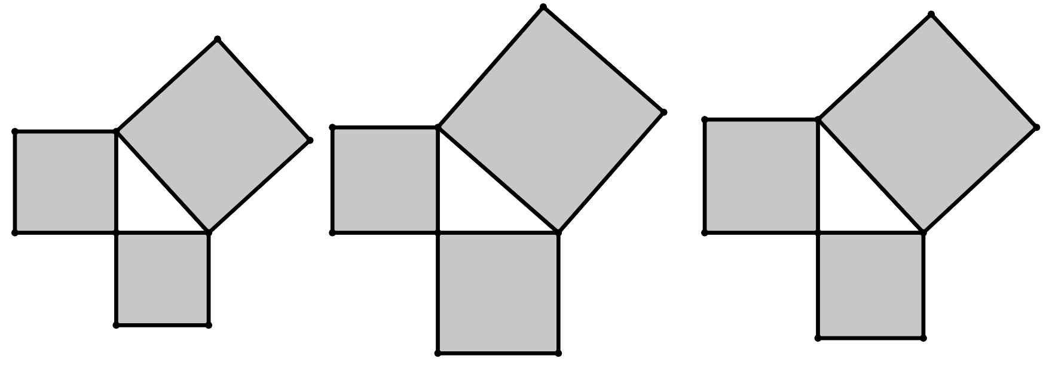
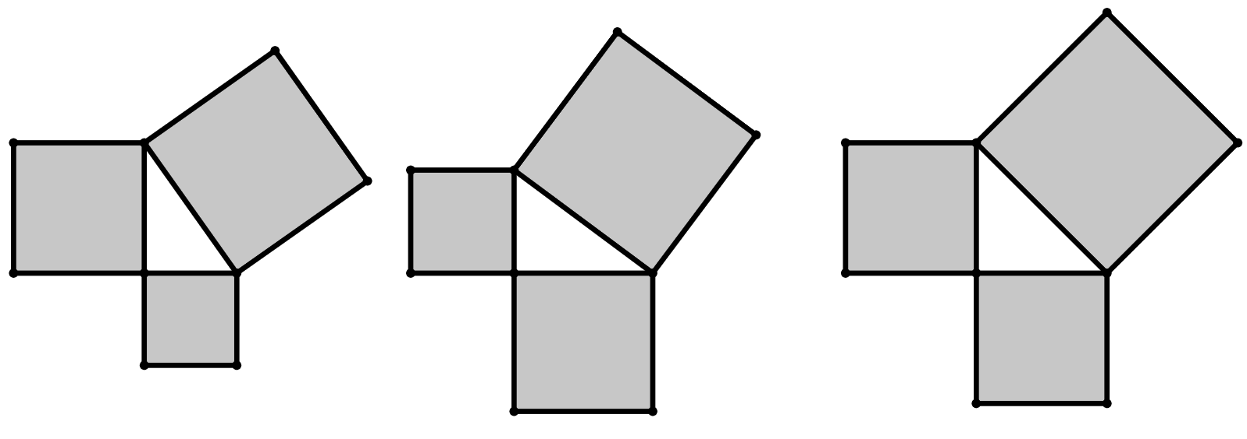
Further demonstrating of Pythagoras' theorem
Task A: Generating right-angles triangles from squares
1) For each of these right-angled triangles, find the area of each unlabelled square.
a)
b)
17
units²
c)
15
units²
22
units²
13
units²
12
units²
13
units²
30
units²
28
units²
10
units²
2) For each of these right-angled triangles, find the area of all squares.
a)
b)
c)
8
units²
8
units²
12
units²
14
units²
8
units²
4
units²
5
units²
9
units²
16
units²
3 units
2 units
4 units
v3.0

Slide 2
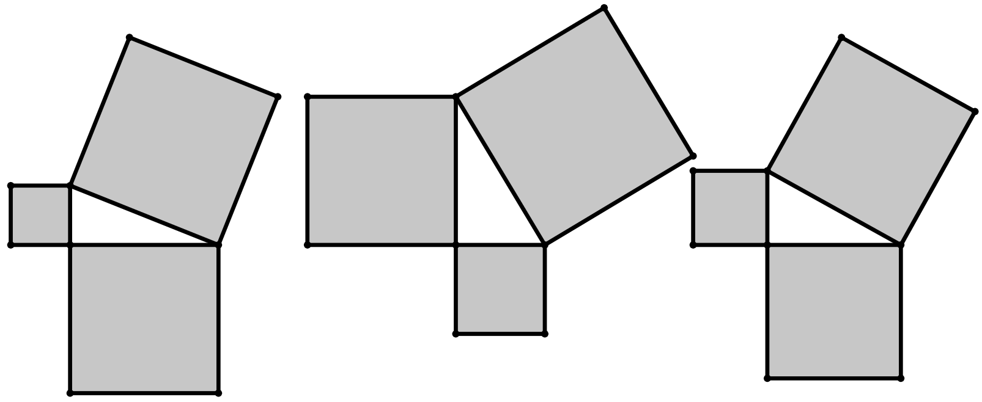
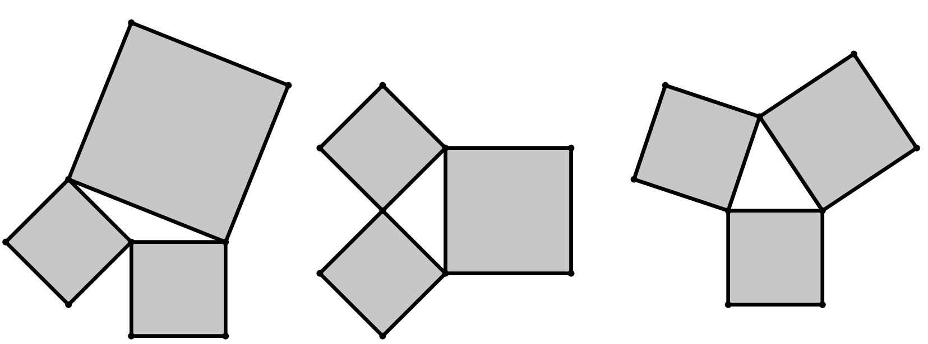

Further demonstrating of Pythagoras' theorem
3) For each of these right-angled triangles, fill in the area of each square and find the missing length of each square that is labelled with a letter.
a)
b)
c)
a = 7
c = 8
d = 13
c units
d units
13
units²
a units
169
units²
49
units²
39
units²
64
units²
25
units²
36
units²
25
units²
e
units
144
units²
b units
e = 5
6 units
b = 5
12 units
Task B: Introducing Pythagoras’ theorem
1) On which of these diagrams is Pythagoras’ theorem true?
a)
b)
c)
27
units²
14
units²
18
units²
21
units²
10 units²
28
units²
11
units²
14
units²
16
units²
2) Explain your reasoning for question 1).
b is the only diagram where the sum of the two smaller areas is equal to the larger area. This is the only right-angled triangle.

Slide 3
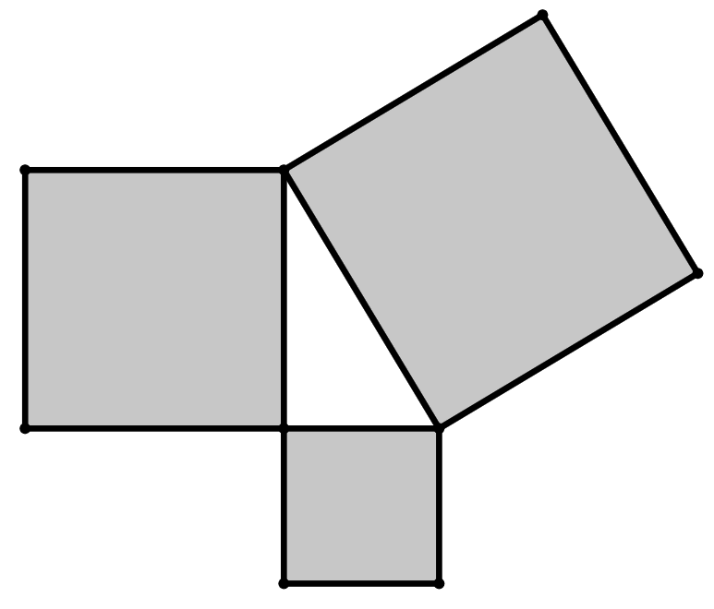

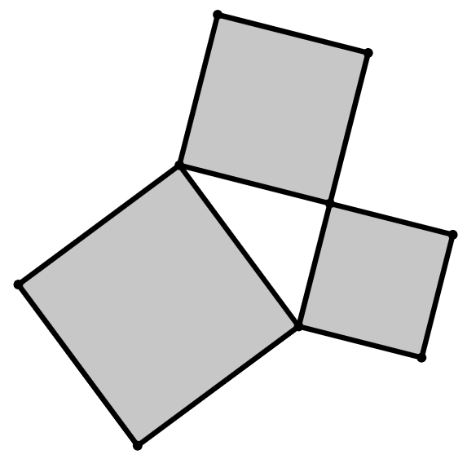
Further demonstrating of Pythagoras' theorem
3) Which of these are valid representations of Pythagoras’ theorem for these three squares which enclose a right-angled triangle?
square H
area of square F plus the area of square G equals the area of square H
h units
a
square F
b
f ² + g² = h²
c
f ² = g² + h²
f units
square G
d
h² = g² + f ²
g units
4) a) What could 15² represent in this diagram?
b) What is the area of the largest square?
c) Fill in the blanks for these calculations of Pythagoras’ theorem.
15² is the area of square B
Square C has an area of 289 units²
square B
15 units
square C
square A
8 units
8
2
+
15
2
=
17
2
17 units
64
+
225
=
289
area of square A
area of square B
area of square C
Mathematics in Education and Industry.

